Slide 1
Welcome to UNE
Keep your mobile phone, Laptop, Tablet on (but on silent)
- you’ll need to use it :-)

Slide 2
Acknowledgement of Country
Notes:
I want to acknowledge that today we are meeting on the traditional land of the Aniwan people. The Aniwan people share in the care of this country with the Gumbaynggirr (Gum – bang gi), Kamilaroi (Ka-mil-a-roy), and Dhunghutti (Dun-ga-ti) nations. I would like to pay my respect to the Elders, past and present, of these nations.

Slide 3
Pro Vice Chancellor, External Relations
Professor
Mingan Choct

Slide 4
Keynote speaker
Zach Byfield

Slide 5
The Student Support Team’s
guide to UNE

Slide 6
Hello! My name is
Ed Campbell
Student Support team
facebook.com/Ed.UNE
Ph: 6773 4430
E: studentsupport@une.edu.au

Slide 7
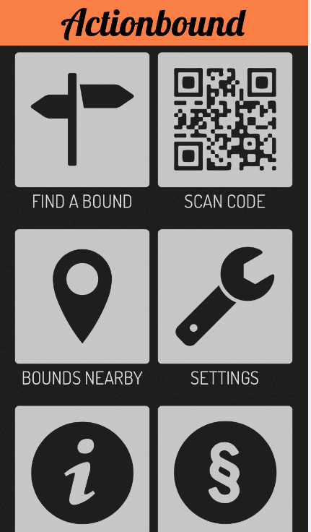
Actionbound
Download and install the free Actionbound App to your phone/tablet
#Orientation18
Notes:
- the first step is to take out your mobile device
- go to the app store or equivalent and download Actionbound

Slide 8
Actionbound
Find a teammate or two (max 3 per team)
Click on ‘bounds nearby’ - Give AB access to your location
Click on the map pin and start the ‘Orientation Challenge - Trimester 2, 2018’
Enter your team name
Enter your full names (or student #) so we can find you to give you your prizes
Drop into Student Support helpdesk in the Dixson Library foyer for help
#Orientation18
Notes:
Find a teammate or two (max 3 per team)
Click on ‘bounds nearby’ - Give AB access to your location
Click on the map pin and start the ‘Orientation Challenge - Trimester 2, 2018’
Enter your team name
Enter your full names (or student #) so we can find you to give you your prizes
Drop into Student Support helpdesk in the Dixson Library foyer for help

Slide 9
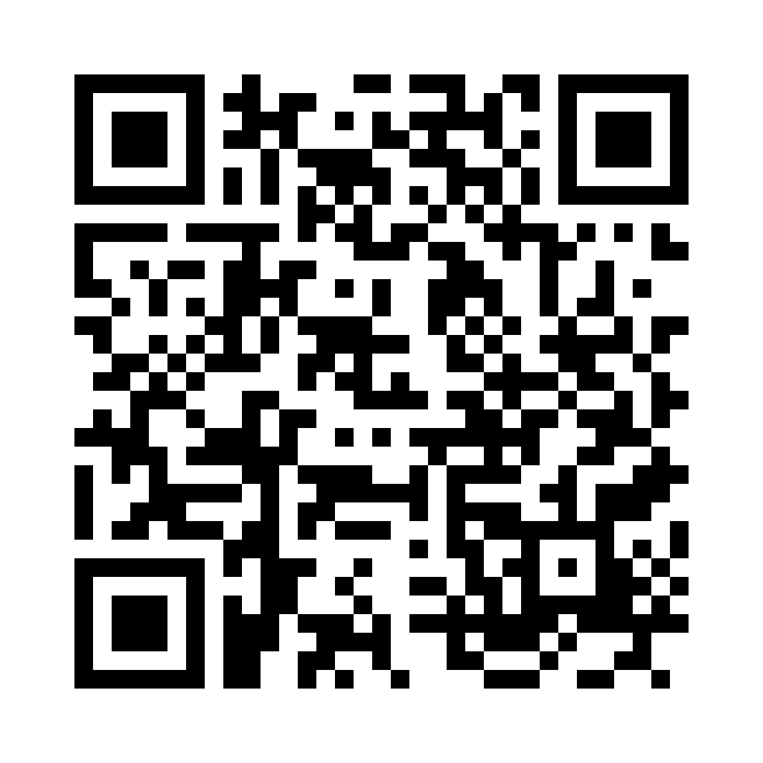
Actionbound
Orientation Challenge - Trimester 2, 2018
Stage 1 - Find your support staff
Stage 2 - Find things (use GPS, scan QR Codes)
Stage 3 - Tell us what you learnt
Enter and win prizes
A QR Code Minding its own business
#Orientation18
Notes:
there are three stages that you can complete in any order
Stage 1 - Find your support staff Stage 2 - Find things (use GPS, scan QR Codes) Stage 3 - Tell us what you learnt
You will be asked to either answer a quiz question, take a selfie, find a location with GPS, or scan a QR Code.
Once you have finished, upload your entries and we will be in contact with the winner. Don’t forget to use your full name, UNE email or student number when you enter your details.

Slide 10
what we’re going to do today
meet people & get skills
know what support is available
know where to find help

Slide 11
Your challenge is:
get the most
out of your time @ une.

Slide 12
“There is nothing you can ask that we haven’t helped someone with before”

Slide 13
getting started tips

Slide 14
stay in touch.

Slide 15
www.une.edu.au/insidersguide
www.facebook.com/EdUne
www.twitter.com/UNESupport

Slide 16
get help.

Slide 17
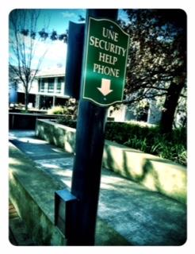
Help is at hand … you just need to ask!
Student Support Team
Emoticons
The Vibe
Email
Facebook
Twitter
Uni4Me
Free, confidential, impartial & independent support: Uni4Me.
Safety & Security
Library Helpdesk
Near Colleges
Ph: 6773 2099
Light Poles!

Slide 18
First Year Advisors
Academic Skills Office
Library, Oorala
International Office
Unit Coordinators, Course Coordinators, Year Convenors etc

Slide 19
Career Development
Counselling
Special Needs
Student Grievance Unit

Slide 20
Student Success
Helpdesk in the Library
Call 02 6773 2000 or use AskUNE

Slide 21
get organised.

Slide 22
Weekly Study Guide
Weekly Email (straight to your inbox)
Mark your Assignment deadlines down (Wallplanners are in your Commencement Packs!)
Complete the Academic Integrity Module (A.I.M)

Slide 23
Learn how to write & reference
Academic Skills Office + Library + First Year Advisors
[make the most of your sessions later today!]

Slide 24
stay healthy

Slide 25
Medical Centre
SportUNE

Slide 26
Have Fun!
If you’re not enjoying what you’re studying, get help to find something you do.

Slide 27
Eat, Study, Sleep, repeat.
NO!

Slide 28
build relationships
Clubs + Societies & Student Groups
New England Award
UNE Student Association
TUNE!FM
Unit Coordinators, Course Coordinators,
Year Convenors etc.

Slide 29
Get to know une … but
Don’t forget the local community …
http://www.armidale.nsw.gov.au/community-directory

Slide 30
computer says no!

Slide 31
IT Helpdesk
Same hours as the Library (including Weekends)
PH 6773 5000 or 1800 763 040
Note IT Maintenance Outages (one per month on Saturdays)
Use free Microsoft Office while you’re a student!
Download Sophos Anti-Virus (also free ... Ka-ching)

Slide 32
Find your voice :-)

Slide 33
Emoticons
The Vibe
International Office
Student Grievance Unit

Slide 34
Remember ...
Get Help.
Student Support Team
International Office
Special Needs Unit
Academic Skills Office
Stay Healthy.
Medical Centre
Counselling
SportUNE
Have fun.
Clubs & Socs
Community
Find your voice.
emoticons
the Vibe
Student Grievance Unit
Build relationships
Each other!
Unit/Course Coords
Uni4Me Blueshirts
Be smart!
Get skills
Get organised
Keep your eyes on the prize.

